Slide 1

Department of Industrial Engineering & Management
ENMG 616 – Advanced Optimization Techniques & Algorithms
Research Project: Fairness in Machine Learning
By – Ralph Mouawad – ID 202204667
To – Dr. Maher Nouiehed

Slide 2
“Fairness Beyond Disparate Treatment and Disparate Impact:
Learning Classification without Disparate Mistreatment”
By:
- Muhammad Bilal Zafar
- Isabel Valera
- Manuel Gomez Rodriguez
- Krishna P. Gummadi

Slide 3

OUTLINE
1- Introduction & Motivation
2- Literature Review
3- Problem Formulation & Methodology
4- Experiments & Results
5- Relation to the Class Material

Slide 4
1- Introduction & Motivation
- Huge increase in Automated data-driven decision systems
- Concerns about unfairness towards groups of people with sensitive attributes such as gender or race.
- Several laws tackled Disparate Treatment & Disparate Impact, when ground truth is not provided.
- If the ground truth is provided, we can find that sometimes a certain group of people should receive different decisions.
→ DISPARATE MISTREATMENT is introduced

Slide 5
Definitions:
- Disparate Treatment: When a decision-making system assigns different classifications to groups of people with the same non-sensitive attributes but differing sensitive attributes, it exhibits Disparate Treatment.
- Disparate Impact: This form of unfairness occurs when a decision-making system
consistently produces outcomes that disproportionately favor or disadvantage a specific
group of individuals sharing a common sensitive attribute value, more frequently than
other groups
- Disparate Mistreatment: A decision-making system is labeled as experiencing Disparate Mistreatment when the misclassification rate for a group of individuals with the same value of a sensitive attribute differs from another group with a different value of that sensitive attribute.

Slide 6
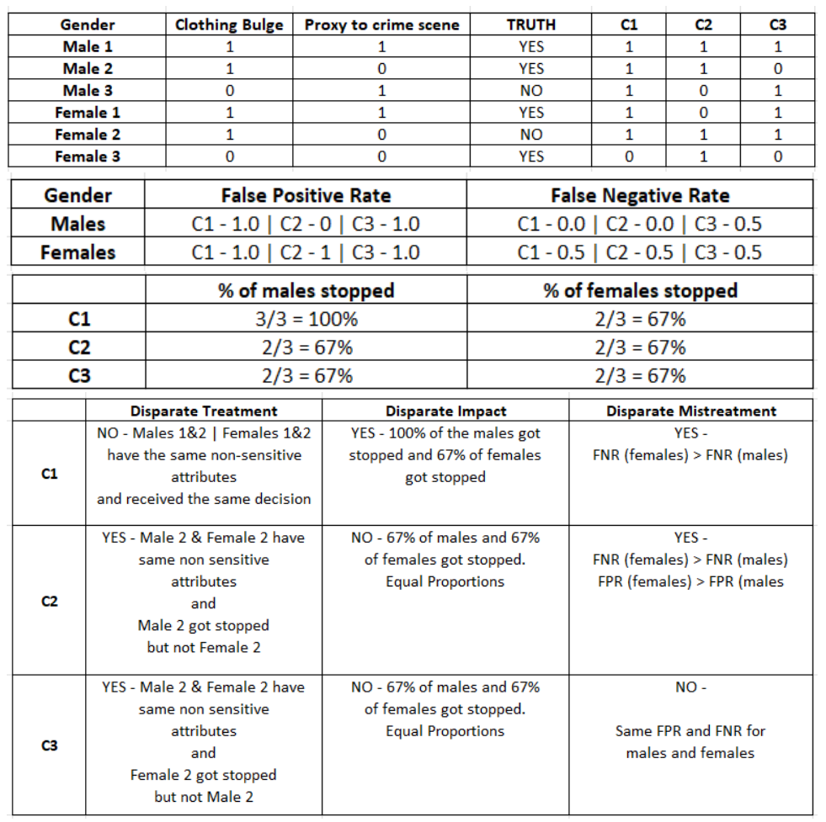
Example:
We have 3 classifiers that will decide whether or not to stop pedestrians because they think they might have weapons. We have one sensitive attribute that is Gender, and two non sensitive attributes, Clothing Bulge and Proximity to a crime scene.

Slide 7
2- Literature Review
- Many Studies only tackle Disparate Treatment & Impact
- Goel et al: Raised awareness about unfairness towards black people regarding racial disparities in the detection of weapons with civilians.
- Hardt et al: tackle disparate mistreatment: Ad-
just the unfair system’s probability estimates after it makes predictions. This adjustment
helps the system set different decision thresholds for various sensitive attribute groups.
However, this method has a limitation: it needs sensitive attribute information at the time
of decision-making. So, it may not work when this information is unavailable.

Slide 8
3- Problem Formulation & Methodology
Min L(θ)
We aim to find a function f(x) that maps user feature vectors x ∈ R^{d} and class labels y ∈ {−1, 1}.
To achieve this, we need to determine a decision boundary θ ∗ = argminL(θ) (a surface separating the data-points of different classes) using a training dataset D = {(xi , yi)} for i = 1 to N.
Then, when we’re given a new feature vector x, the system will be able to predict whether yˆ = 1 (if dθ ∗ (x) ≥ 0) or yˆ = −1 if (dθ ∗ ((x)) < 0).
dθ ∗(x) represents the signed distance from x to the decision boundary. If it is on the positive side, ˆy = 1, and ˆy = −1 otherwise.
In this paper, a logistic regression model will be used. The decision boundary here will be the hyperplane defined by θ^{T}x = 0, and dθ(x) = θ^{T}x. Consider that we have a feature vector x and a sensitive attribute z = {0, 1}. The constraints for the three notions of fairness will be defined as follow:

Slide 9
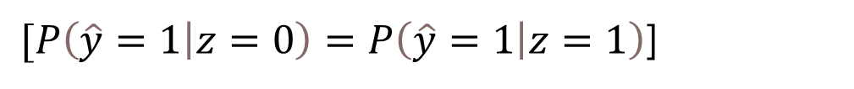
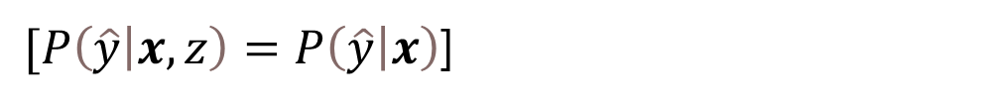
Fairness Constraints
Disparate Treatment: The Probability that a classifier outputs a value of y^, given the feature vector x, must remain the same if the sensitive attribute z is also given
$[P\left(\hat{y} | x,z\right)=P\left(\hat{y} | x\right)$]
Disparate Impact: The Probability of getting the output y^=1 (or 0) should be the same for both values of the sensitive feature z
$[P\left(\hat{y}=1 | z=0\right)=P\left(\hat{y}=1 | z=1\right)$]

Slide 10
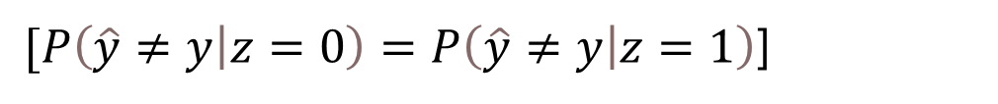
Disparate Mistreatment: The misclassification rates for different groups of people having different values of z should remain the same. Here we have many misclassification measures, such as:
- Overall Misclassification Rate:
$[P\left(\hat{y}≠y | z=0\right)=P\left(\hat{y}≠y | z=1\right)$]
- False Positive Rate:
$$\left[P\left(\hat{y}≠y | z=0,y=−1\right)=P\left(\hat{y}≠y | z=1,y=−1\right)\right]$$
- False Negative Rate:
$$\left[P\left(\hat{y}≠y | z=0,y=1\right)=P\left(\hat{y}≠y | z=1,y=1\right)\right]$$
We will only cover these types, but there’s also False Omission rate and False Discovery Rate

Slide 11

Simplifying the fairness constraints to make them a Discipline Convex Concave Program (DCCP)
- Step 1: Measure disparate mistreatment using the covariance between the users’ sensitive attribute values (z), and the signed distance between the feature vectors of misclassified users and the decision boundary g(y,x)
$OMR: g_{θ}\left(y,x\right)=\min\left(0,y⋅d_{θ}\left(x\right)\right)$
$FPR: g_{θ}\left(y,x\right)=\min\left(0,\frac{1−y}{2}⋅yd_{θ}\left(x\right)\right)$
$FNR: g_{θ}\left(y,x\right)=\min\left(0,\frac{1+y}{2}⋅yd_{θ}\left(x\right)\right)$

Slide 12

min$L\left(θ\right)$
Subject to:
$$\frac{1}{N}\sum_{\left(x,y,z\right)∈D}{\left(z−\overline{z}\right)g_{θ}\left(y,x\right)}≤ −c$$
$$\frac{1}{N}\sum_{\left(x,y,z\right)∈D}{\left(z−\overline{z}\right)g_{θ}\left(y,x\right)}≥−c$$

Slide 13
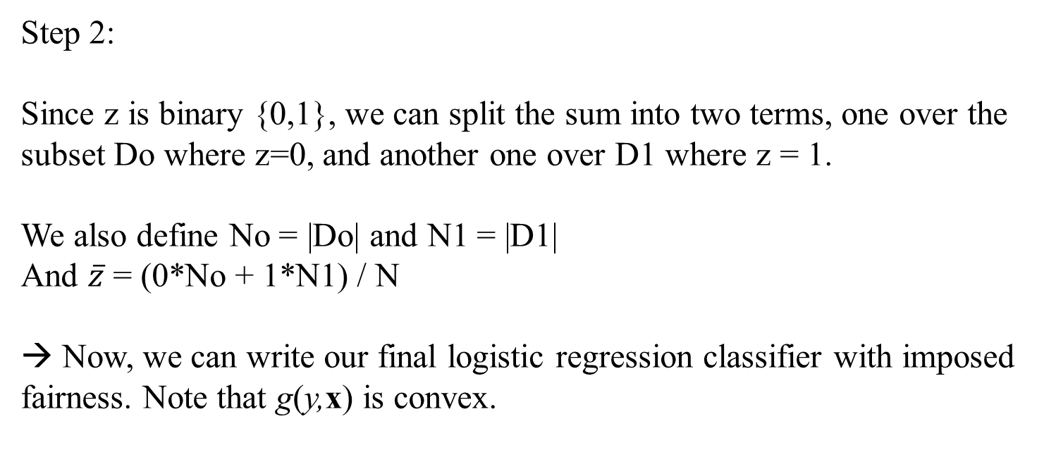
Step 2:
Since z is binary {0,1}, we can split the sum into two terms, one over the subset Do where z=0, and another one over D1 where z = 1.
We also define No = |Do| and N1 = |D1|
And $\overline{z}$ = (0*No + 1*N1) / N
→ Now, we can write our final logistic regression classifier with imposed fairness. Note that g(y,x) is convex.

Slide 14
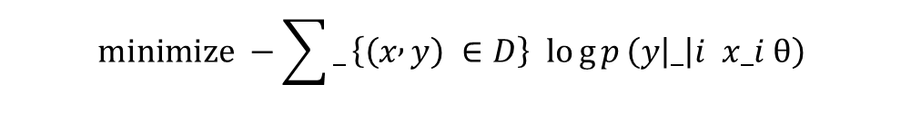
$$minimize −\sum{_}\left\{\left(x , y\right) ∈D\right\} log{p}\left(y | _ | i x_i θ\right)$$
Subjected to:
$$−\left(N1/N\right)\sum_{\left(x,y\right)∈D_{0}}{g_{θ}\left(y,x\right)}+\left(No/N\right)\sum_{\left(x,y\right)∈D_{1}}{g_{θ}\left(y,x\right)}≤c$$
$$−\left(N1/N\right)\sum_{\left(x,y\right)∈D_{0}}{g_{θ}\left(y,x\right)}+\left(No/N\right)\sum_{\left(x,y\right)∈D_{1}}{g_{θ}\left(y,x\right)}≥−c$$
DCCP can be solved by using advances in convex-concave programming.

Slide 15
4- Experiments and Results Synthetic Dataset
D (FPR) =
$$\left[P\left(\hat{y}≠y | z=0,y=−1\right)−P\left(\hat{y}≠y | z=1,y=−1\right)\right]$$
D (FNR) =
$$\left[P\left(\hat{y}≠y | z=0,y=1\right)−P\left(\hat{y}≠y | z=1,y=1\right)\right]$$
At each experiment, 4 samples (each 2500 points) with different distributions will be generated, and the logistic classifier will be solved first without the fairness constraints to see the new results when imposing them.

Slide 16
1- Removing disparate mistreatment on FPR or FNR
 | Unconstrained Classifier | Fairness constraint on FPR
Accuracy | 0.85 | 0.8
D (FPR) | 0.19 | 0.02
D (FNR) | 0 | 0

Slide 17
2) Removing Disparate mistreatment on both FPR & FNR
Case 1 – D (FPR) & D( FNR) have opposite signs
When the decision boundary rotated due to the constraints, misclassified examples with z = 1 move to the negative class as well as well classified examples with z = 1. This caused a decrease in FPR and an increase on FNR
 | Unconstrained | Fairness on FPR | Fairness on FNR | Fairness on both
Accuracy | 0.78 | 0.75 | 0.75 | 0.75
D (FPR) | -0.16 | 0 | 0 | 0
D (FNR) | 0.19 | 0 | 0 | 0

Slide 18
Case 2 – D (FPR) and D (FNR) have same sign
When the decision boundary rotates to include more well-classified examples with z = 0 in the positive class, it will also move previously well classified negative examples to the positive class, which will increase FPR.
 | Unconstrained | Fairness on FPR | Fairness on FNR | Fairness on both
Accuracy | 0.8 | 0.77 | 0.77 | 0.69
D (FPR) | 0.25 | 0 | 0.56 | 0.02
D (FNR) | 0.14 | 0.19 | 0.04 | 0.03

Slide 19
Performance Evaluation on a real dataset
We will compare:
- Method 1 removing only disparate mistreatment
- Hardt et al. Method
- Baseline: Remove disparate mistreatment by:
Running the unfair classifier, selecting the set of misclassified data with higher error, and re-training the model with an increased penalty on this set until fariness is achieved.

Slide 20
Real dataset info
- Info on offenders’ demographic features.
- Take into account race (black, white).
- Use the ground truth to build different logistic classifiers

Slide 21
FPR | FNR | BOTH CONSTRAINTS
Acc D(FPR) D(FNR) | Acc D(FPR) D(FNR) | Acc D(FPR) D(FNR)
Unfair NO FPR | 0.668 NO FPR CNT | 0.18 NO FPR CNT | -0.3 NO FPR CNT
Method 1 | 0.66 | 0.06 | -0.14 | 0.662 | 0.03 | -0.1 | 0.661 | 0.03 | -0.11
Baseline | 0.64 | 0.03 | -0.11 | 0.66 | 0.00 | -0.07 | 0.660 | 0.01 | -0.09
Hardt | 0.66 | 0.02 | -0.08 | 0.65 | -0.06 | -0.01 | 0.645 | -0.01 | -0.01

Slide 22
Results
For all three mehtods, controlling for disparate mistreatment on false positive rate (false negative rate) also helps decrease disparate mistreatment on false negative rate (false positive rate). Moreover, all three methods are able to achieve similar accuracy for a given level of fairness
Due to the small size, disparate mistreatment isn’t removed completely.

Slide 23
Relation to class material
- Constrained Optimization
- Convexity
- Logistic Regression

